Slide 1
HTML5
HTML5 introduces a number of new elements and attributes that can help you in building modern websites. Here is a set of some of the most prominent features introduced in HTML5.

Slide 2
New Semantic Elements − These are like <header>, <footer>, and <section>.
Forms 2.0 − Improvements to HTML web forms where new attributes have been introduced for <input> tag.
Persistent Local Storage − To achieve without resorting to third-party plugins.
WebSocket − A next-generation bidirectional communication technology for web applications.
Server-Sent Events − HTML5 introduces events which flow from web server to the web browsers and they are called Server-Sent Events (SSE).
Canvas − This supports a two-dimensional drawing surface that you can program with JavaScript.
Audio & Video − You can embed audio or video on your webpages without resorting to third-party plugins.
Geolocation − Now visitors can choose to share their physical location with your web application.
Microdata − This lets you create your own vocabularies beyond HTML5 and extend your web pages with custom semantics.
Drag and drop − Drag and drop the items from one location to another location on the same webpage.

Slide 3
HTML 5 does not have the same syntax rules as XHTML where we needed lower case tag names, quoting our attributes, an attribute had to have a value and to close all empty elements.
HTML5 comes with a lot of flexibility and it supports the following features −
Uppercase tag names.
Quotes are optional for attributes.
Attribute values are optional.
Closing empty elements are optional.

Slide 4
The <script> tag
It's common practice to add a type attribute with a value of "text/javascript" to script elements as follows −
<script type = "text/javascript" src = scriptfile.js"></script>
HTML 5 removes extra information required and you can use simply following syntax −
<script src = "scriptfile.js"></script>

Slide 5
The <link> tag
So far you were writing <link> as follows −
<link rel = "stylesheet" type = "text/css" href = "stylefile.css">
HTML 5 removes extra information required and you can simply use the following syntax −
<link rel = "stylesheet" href = "stylefile.css">

Slide 6
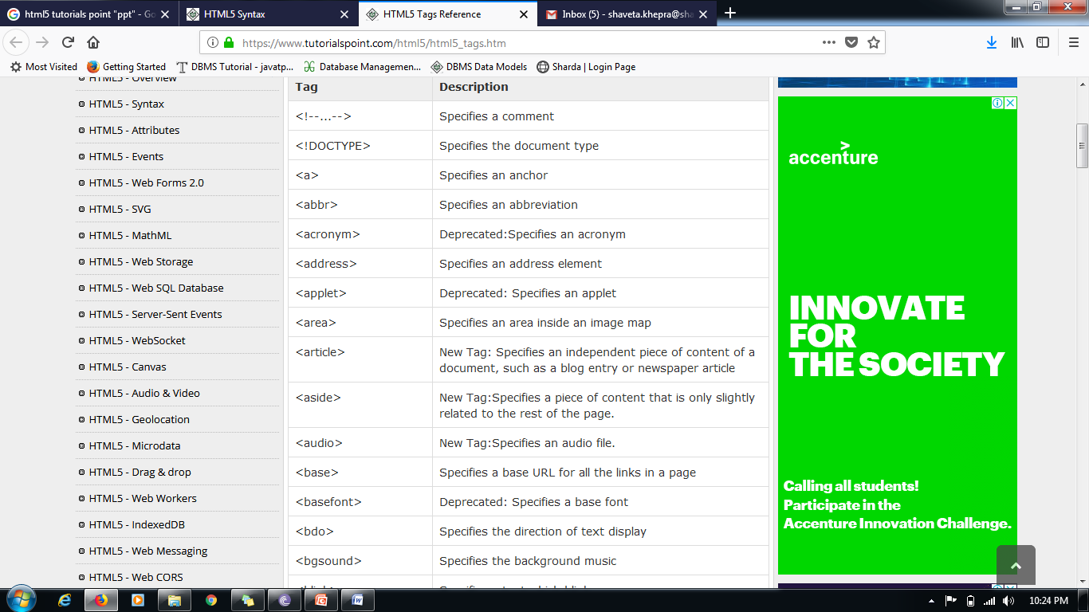
HTML5 Elements

Slide 7
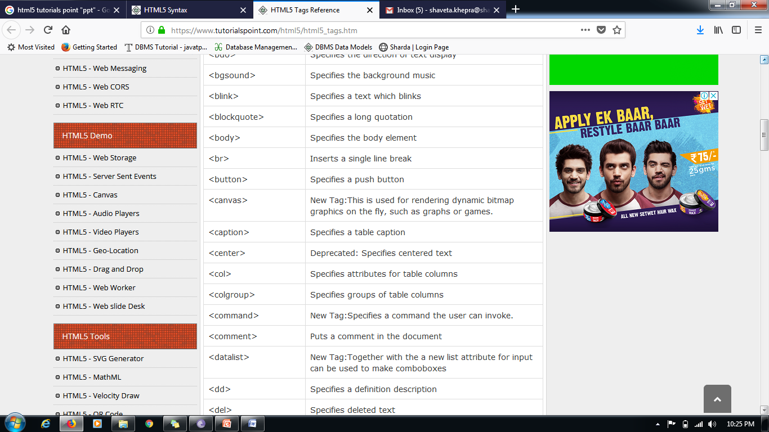

Slide 8
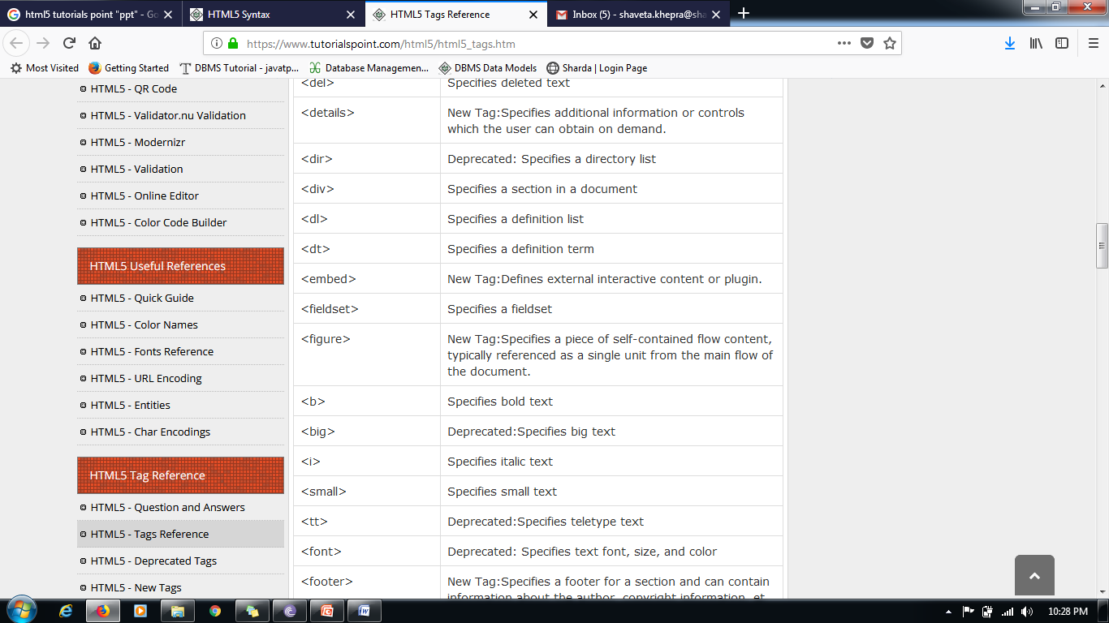

Slide 9
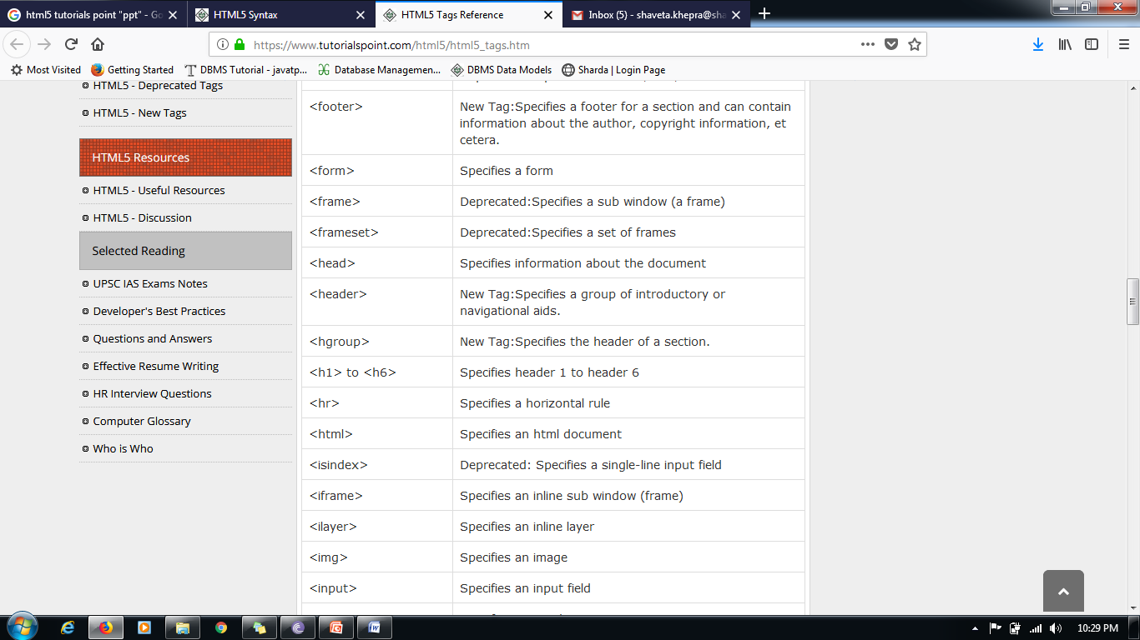

Slide 10
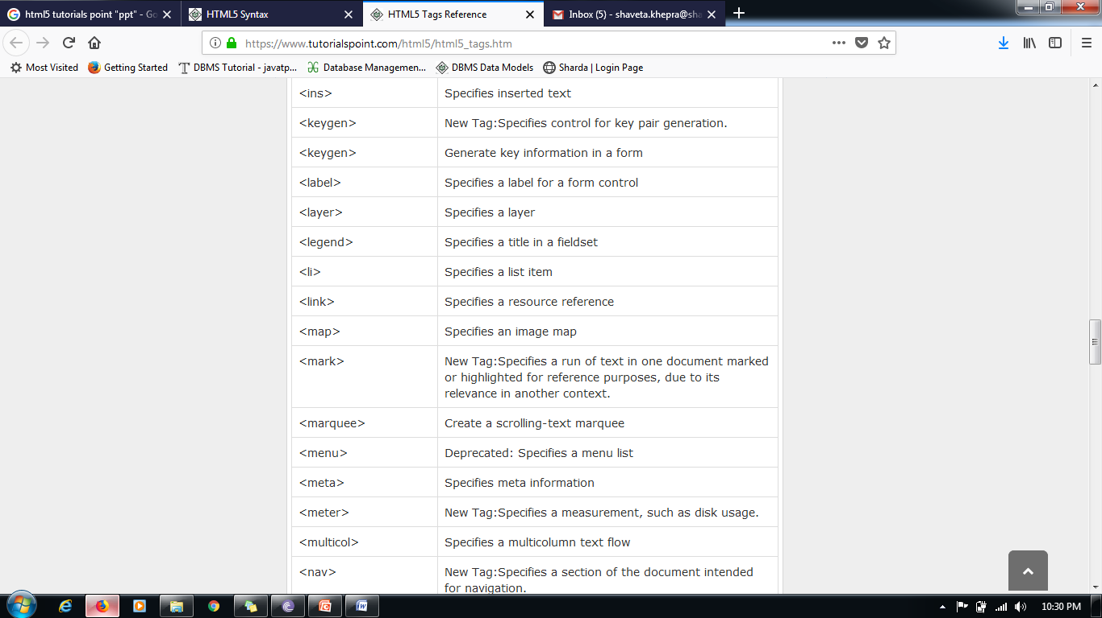

Slide 11
HTML5 - Canvas
HTML5 element <canvas> gives you an easy and powerful way to draw graphics using JavaScript. It can be used to draw graphs, make photo compositions or do simple (and not so simple) animations.
Here is a simple <canvas> element which has only two specific attributes width and height plus all the core HTML5 attributes like id, name and class, etc.
<canvas id = "mycanvas" width = "100" height = "100"></canvas> You can easily find that <canvas> element in the DOM using getElementById() method as follows −
var canvas = document.getElementById("mycanvas");

Slide 12
Example
<!DOCTYPE HTML>
<html>
<head>
<style>
#mycanvas{border:1px solid red;}
</style>
</head>
<body>
<canvas id = "mycanvas" width = "100" height = "100"></canvas>
</body>
</html>

Slide 13
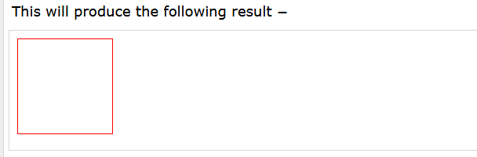
Output

Slide 14
The Rendering Context
The <canvas> is initially blank, and to display something, a script first needs to access the rendering context and draw on it.
The canvas element has a DOM method called getContext, used to obtain the rendering context and its drawing functions. This function takes one parameter, the type of context2d.

Slide 15
Following is the code to get required context along with a check if your browser supports <canvas> element −
var canvas = document.getElementById("mycanvas");
if (canvas.getContext) {
var ctx = canvas.getContext('2d');
// drawing code here
} else {
// canvas-unsupported code here
}

Slide 16
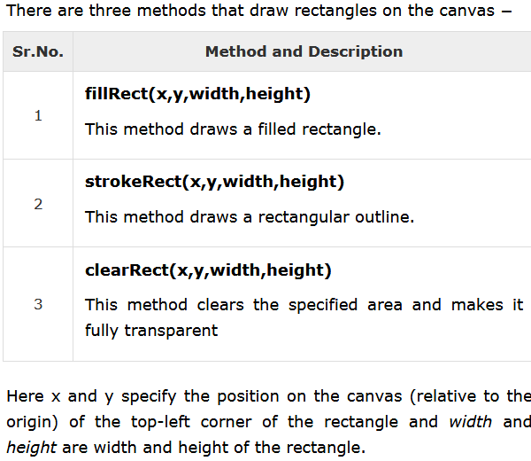

Slide 17
<!DOCTYPE HTML>
<html> <head> <style>
#test { width: 100px; height:100px; margin: 0px auto; }
</style>
<script type = "text/javascript">
function drawShape() {
// Get the canvas element using the DOM
var canvas = document.getElementById('mycanvas');
// Make sure we don't execute when canvas isn't supported
if (canvas.getContext) {
// use getContext to use the canvas for drawing
var ctx = canvas.getContext('2d');
// Draw shapes
ctx.fillRect(25,25,100,100);
ctx.clearRect(45,45,60,60);
ctx.strokeRect(50,50,50,50);
} else { alert('You need Safari or Firefox 1.5+ to see this demo.'); }
</script> </head>
<body id = "test" onload = "drawShape();">
<canvas id = "mycanvas"></canvas>
</body> </html>

Slide 18
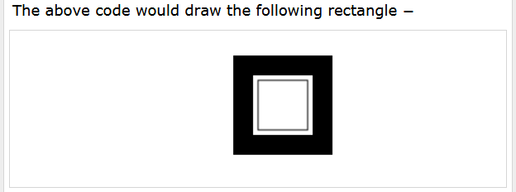

Slide 19
HTML5 Canvas - Drawing Paths
We require the following methods to draw paths on the canvas −
S.No. | Method and Description
1 | beginPath() This method resets the current path.
2 | moveTo(x, y) This method creates a new subpath with the given point.
3 | closePath() This method marks the current subpath as closed, and starts a new subpath with a point the same as the start and end of the newly closed subpath.
4 | fill() This method fills the subpaths with the current fill style.
5 | stroke() This method strokes the subpaths with the current stroke style.
6 | arc(x, y, radius, startAngle, endAngle, anticlockwise) Adds points to the subpath such that the arc described by the circumference of the circle described by the arguments, starting at the given start angle and ending at the given end angle, going in the given direction, is added to the path, connected to the previous point by a straight line.

Slide 20
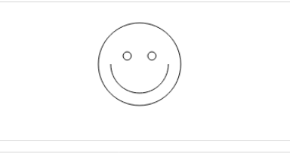
Example

Slide 21
<!DOCTYPE HTML>
<html> <head> <style>
#test { width: 100px; height:100px; margin: 0px auto; } </style>
<script type = "text/javascript">
function drawShape() {
// get the canvas element using the DOM
var canvas = document.getElementById('mycanvas');
// Make sure we don't execute when canvas isn't supported
if (canvas.getContext) {
// use getContext to use the canvas for drawing
var ctx = canvas.getContext('2d');
// Draw shapes
ctx.beginPath();
ctx.arc(75,75,50,0,Math.PI*2,true); // Outer circle
ctx.moveTo(110,75);
ctx.arc(75,75,35,0,Math.PI,false); // Mouth
ctx.moveTo(65,65);
ctx.arc(60,65,5,0,Math.PI*2,true); // Left eye
ctx.moveTo(95,65);
ctx.arc(90,65,5,0,Math.PI*2,true); // Right eye
ctx.stroke();
} else { alert('You need Safari or Firefox 1.5+ to see this demo.'); } }
</script> </head> <body id = "test" onload = "drawShape();">
<canvas id = "mycanvas"></canvas> </body> </html>

Slide 22
Sr.No. | Examples & Description
1 | Drawing Rectangles This method is used to draw rectangle using HTML5 <canvas> element
2 | Drawing Paths This method is used to make shapes using paths in HTML5 <canvas> element
3 | Drawing Lines This method is used to draw lines using HTML5 <canvas> element
4 | Drawing Bezier This method is used to draw Bezier curve using HTML5 <canvas> element
5 | Drawing Quadratic This method is used to draw quadratic curve using HTML5 <canvas> element
6 | Using Images This method is used to use images with HTML5 <canvas> element
7 | Create Gradients This method is used to create gradients using HTML5 <canvas> element
8 | Styles and Colors This method is used to apply styles and colors using HTML5 <canvas> element
9 | Text and Fonts This method is used to draw amazing text using different fonts and their size.
10 | Pattern and Shadow This method is used to draw different patterns and drop shadows.
11 | Canvas States This method is used to save and restore canvas states while doing complex drawings on a canvas.
12 | Canvas Translation This method is used to move the canvas and its origin to a different point in the grid.
13 | Canvas Rotation This method is used to rotate the canvas around the current origin.
14 | Canvas Scaling This method is used to increase or decrease the units in a canvas grid.
15 | Canvas Transform These methods allow modifications directly to the transformation matrix.
16 | Canvas Composition This method is used to mask off certain areas or clear sections from the canvas.
17 | Canvas Animation This method is used to create basic animation using HTML5 canvas and JavaScript.

Slide 23
HTML5 - Audio & Video
HTML5 features include native audio and video support without the need for Flash.
The HTML5 <audio> and <video> tags make it simple to add media to a website. You need to set src attribute to identify the media source and include a controls attribute so the user can play and pause the media.

Slide 24
Embedding Video
Here is the simplest form of embedding a video file in your webpage −
<video src = "foo.mp4" width = "300" height = "200" controls> Your browser does not support the <video> element. </video>
The current HTML5 draft specification does not specify which video formats browsers should support in the video tag. But most commonly used video formats are −
Ogg − Ogg files with Thedora video codec and Vorbis audio codec.
mpeg4 − MPEG4 files with H.264 video codec and AAC audio codec.
You can use <source> tag to specify media along with media type and many other attributes.

Slide 25
Example
<!DOCTYPE HTML>
<html>
<body>
<video width = "300" height = "200" controls autoplay>
<source src = "/html5/foo.ogg" type ="video/ogg" />
<source src = "/html5/foo.mp4" type = "video/mp4" />
Your browser does not support the <video> element.
</video>
</body>
</html>

Slide 26
Video Attribute Specification
Sr.No. | Attribute & Description
1 | autoplay This Boolean attribute if specified, the video will automatically begin to play back as soon as it can do so without stopping to finish loading the data.
2 | autobuffer This Boolean attribute if specified, the video will automatically begin buffering even if it's not set to automatically play.
3 | controls If this attribute is present, it will allow the user to control video playback, including volume, seeking, and pause/resume playback.
4 | height This attribute specifies the height of the video's display area, in CSS pixels.
5 | loop This Boolean attribute if specified, will allow video automatically seek back to the start after reaching at the end.
6 | preload This attribute specifies that the video will be loaded at page load, and ready to run. Ignored if autoplay is present.
7 | poster This is a URL of an image to show until the user plays or seeks.
8 | src The URL of the video to embed. This is optional; you may instead use the <source> element within the video block to specify the video to embed.
9 | width This attribute specifies the width of the video's display area, in CSS pixels.

Slide 27
Embedding Audio
HTML5 supports <audio> tag which is used to embed sound content in an HTML or XHTML document as follows.
<audio src = "foo.wav" controls autoplay> Your browser does not support the <audio> element. </audio>
The current HTML5 draft specification does not specify which audio formats browsers should support in the audio tag.
But most commonly used audio formats are ogg, mp3 and wav.

Slide 28
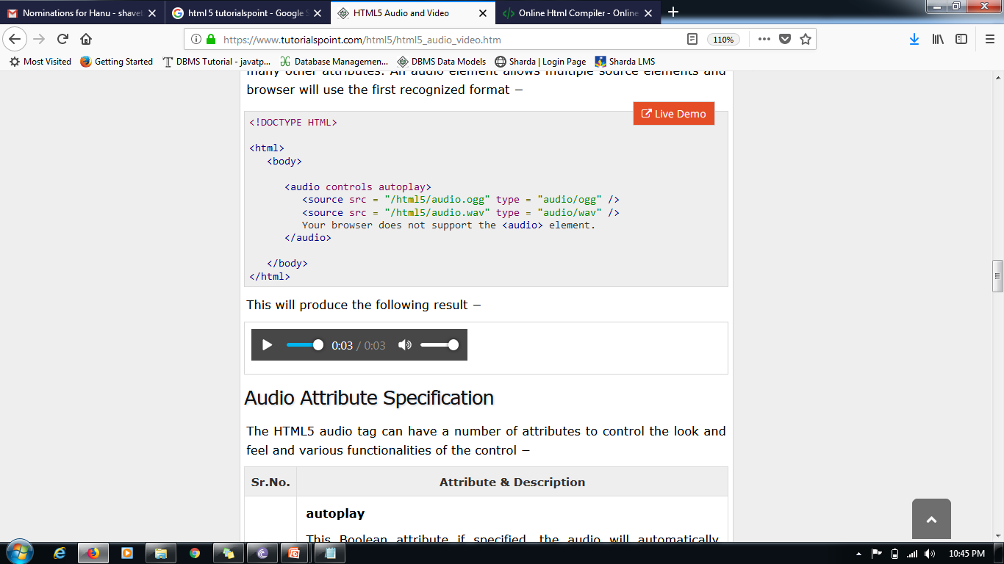
Example
<!DOCTYPE HTML>
<html>
<body>
<audio controls autoplay>
<source src = "/html5/audio.ogg" type = "audio/ogg" />
<source src = "/html5/audio.wav" type = "audio/wav" />
Your browser does not support the <audio> element.
</audio>
</body>
</html>

Slide 29
Audio Attribute Specification
Sr.No. | Attribute & Description
1 | autoplay This Boolean attribute if specified, the audio will automatically begin to play back as soon as it can do so without stopping to finish loading the data.
2 | autobuffer This Boolean attribute if specified, the audio will automatically begin buffering even if it's not set to automatically play.
3 | controls If this attribute is present, it will allow the user to control audio playback, including volume, seeking, and pause/resume playback.
4 | loop This Boolean attribute if specified, will allow audio automatically seek back to the start after reaching at the end.
5 | preload This attribute specifies that the audio will be loaded at page load, and ready to run. Ignored if autoplay is present.
6 | src The URL of the audio to embed. This is optional; you may instead use the <source> element within the video block to specify the video to embed.

Slide 30
HTML5 - Geolocation
HTML5 Geolocation API lets you share your location with your favorite web sites. A JavaScript can capture your latitude and longitude and can be sent to backend web server and do fancy location-aware things like finding local businesses or showing your location on a map.
The geolocation APIs work with a new property of the global navigator object ie. Geolocation object which can be created as follows −
var geolocation = navigator.geolocation; The geolocation object is a service object that allows widgets to retrieve information about the geographic location of the device.

Slide 31
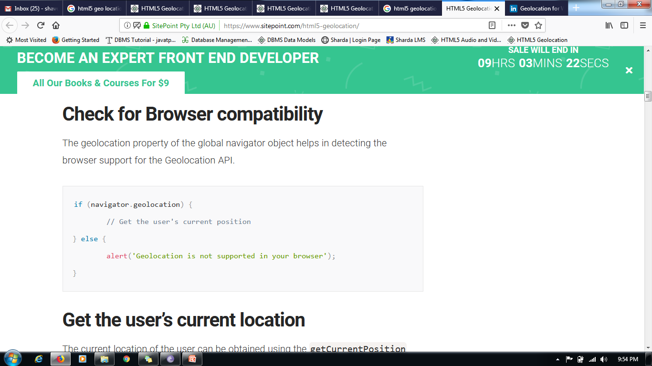
Check for Browser compatibility
The geolocation property of the global navigator object helps in detecting the browser support for the Geolocation API.

Slide 32
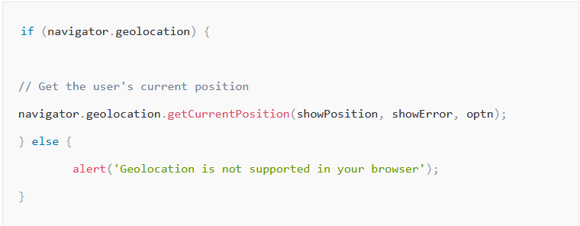
Get the user’s current location
The current location of the user can be obtained using the getCurrentPosition function of the navigator.geolocation object. This function accepts three parameters – Success callback function, Error callback function and position options. If the location data is fetched successfully, the success callback function will be invoked with the obtained position object as its input parameter. Otherwise, the error callback function will be invoked with the error object as its input parameter.

Slide 33
Success callback function
This callback function is invoked only when the user accepts to share the location information and the location data is successfully fetched by the browser. The location data will be available as a position object and the function will be called with the position object as its input parameter. A position object contains a timestamp property denoting the time at which the location data is retrieved and a coords object. The coords object has the following properties
Latitude, longitude – Geographic coordinates in decimal degrees
Accuracy – Accuracy level of the latitude and longitude coordinates in meters. Bigger the number lesser is the accuracy
Altitude – Height of the position above the sea level in meters
AltitudeAccuracy – Denotes how far off the altitude position could be from the actual attitude value obtained in meters. Bigger the number lesser is the accuracy
Heading – Provides 360 degree heading information
Speed – Indicates relative speed in meters per second

Slide 34
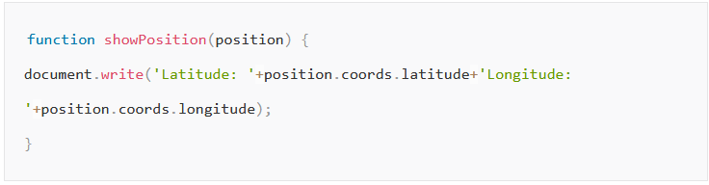

Slide 35
Error callback function
This is an optional callback function that takes a ‘Position Error’ object as its input parameter. This function is invoked under any one of the following circumstances Unknown Error occurred
Request timed out
User has denied to share the location information
Location information itself is unavailable

Slide 36
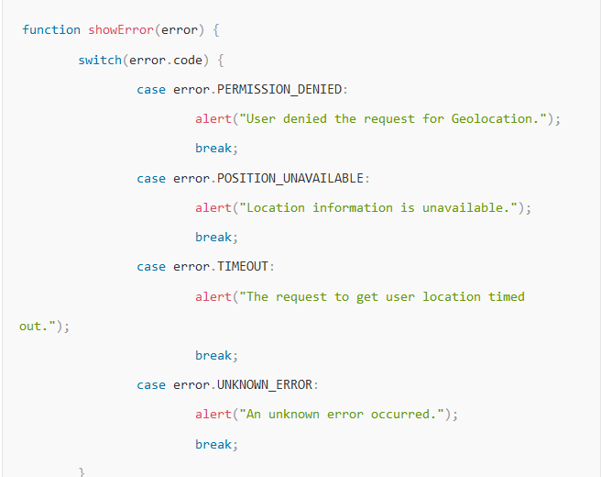

Slide 37
Position Options
It describes the options to use while retrieving the user’s location.
enableHighAccuracy: Boolean. If true, the user agent will try to provide the most accurate position. This can result in slower response time and higher power consumption. Is false, less accurate position will be obtained. Default value is false.
Timeout: Positive long value. It denotes the maximum time (in milliseconds) that the user agent can take to respond with the location data. Default value is Infinity.
maximumAge: Positive long value. It denotes how long (in milliseconds) the user agent can keep using the cached location data before trying to obtain new location data. A zero value indicates that the user agent must not use the cached location data and infinity value indicates that the cached location data must be used by the user agent.

Slide 38
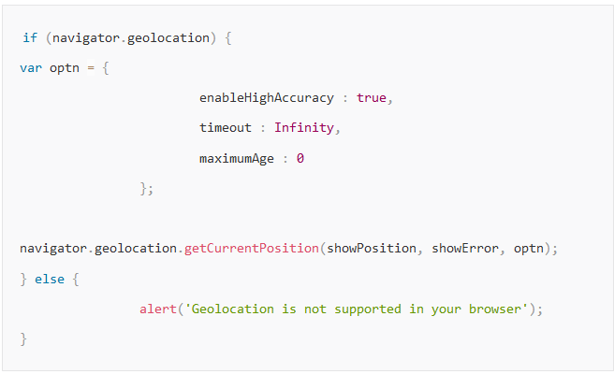

Slide 39
Track Location changes
The watchPosition() can be used to get the location data at regular intervals. The success callback function is invoked automatically as and when the device or the useragent position changes. The parameters to this function is similar to the getCurrentPosition() function. It returns a watch ID value which can be used to unregister the success callback function by passing it to the clearWatch() function.

Slide 40
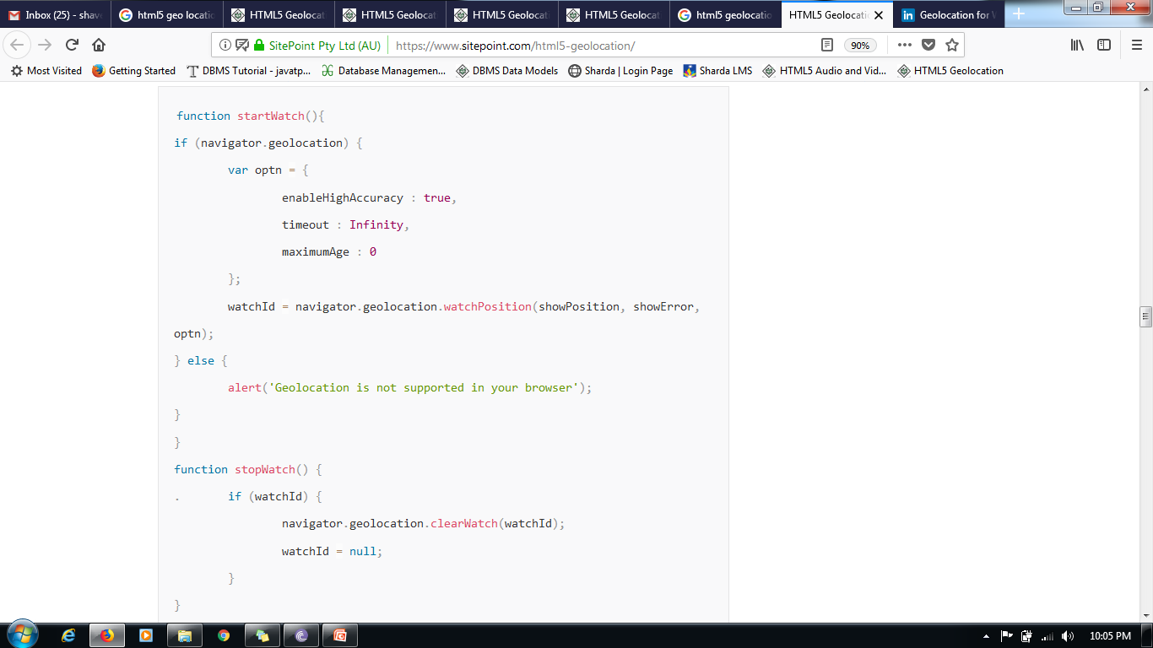

Slide 41
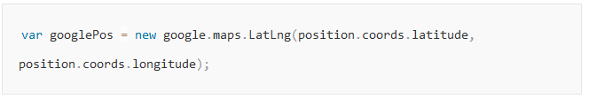
Show My Location on Google Maps
In order to plot your location on Google Maps we can make use of Google Maps API along with Geolocation API.
1. First of all, we should convert the latitude and longitude coordinates of the position object obtained using the Geolocation API into a Google maps latLng object.

Slide 42
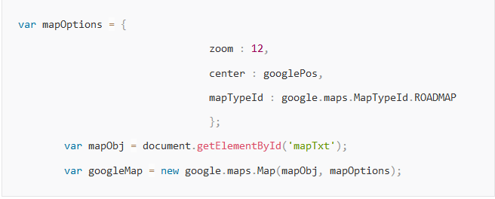
2. Create a Map object specifying the map display options and the HTML div container where the map should be displayed. In the example below three map display options are specified
Zoom – Specifies the zoom level
Center – Specifies that the map should be centered at the user location
mapTypeId – Can be Roadmap, Satellite or Hybrid

Slide 43
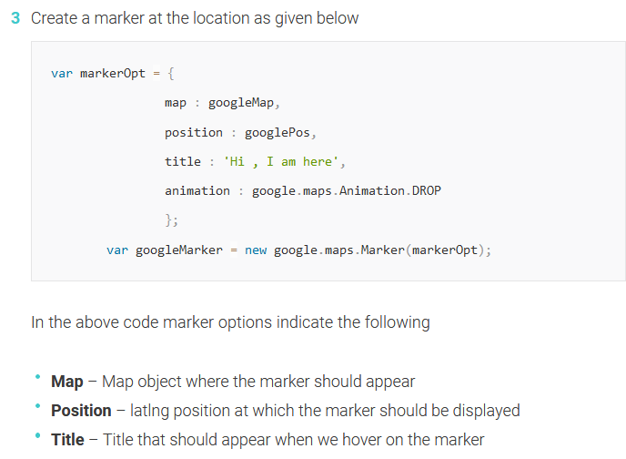

Slide 44
4. Find the address of your location using the reverse geocoding API and show the address obtained when you click on the marker.
var geocoder = new google.maps.Geocoder();
geocoder.geocode({
'latLng' : googlePos
}, function(results, status) {
if (status == google.maps.GeocoderStatus.OK) {
if (results[1]) {
var popOpts = {
content : results[1].formatted_address,
position : googlePos
};
var popup = new google.maps.InfoWindow(popOpts);
google.maps.event.addListener(googleMarker, 'click', function() {
popup.open(googleMap); });
} else { alert('No results found'); }
} else {
alert('Geocoder failed due to: ' + status); }});

